Slide 1
Week 1
05/16/23 - 05/19/23

Slide 2

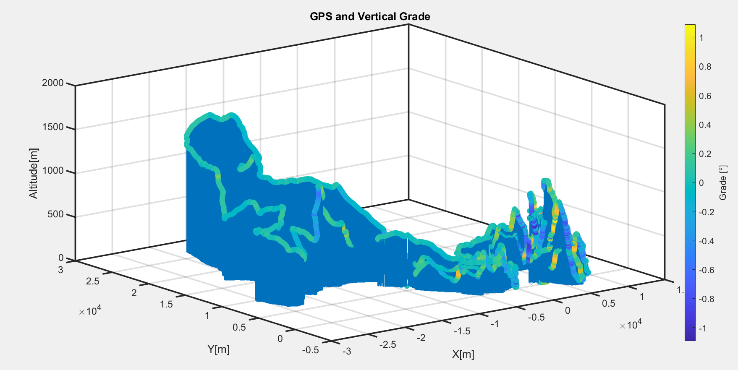
Track map
Grades are capped at 70°

Slide 3
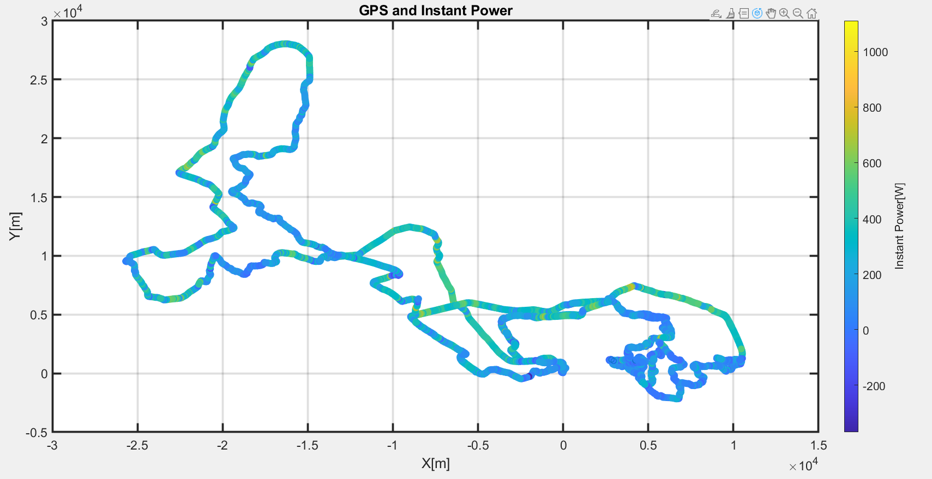
Track map and Power Demand
2300kg
Max Power
~890kW
Correction (05/30/23) ~600kwh
Energy Consumed 780kWh
Correction (05/30/23) ~515kwh
Mass 3500kg

Slide 4
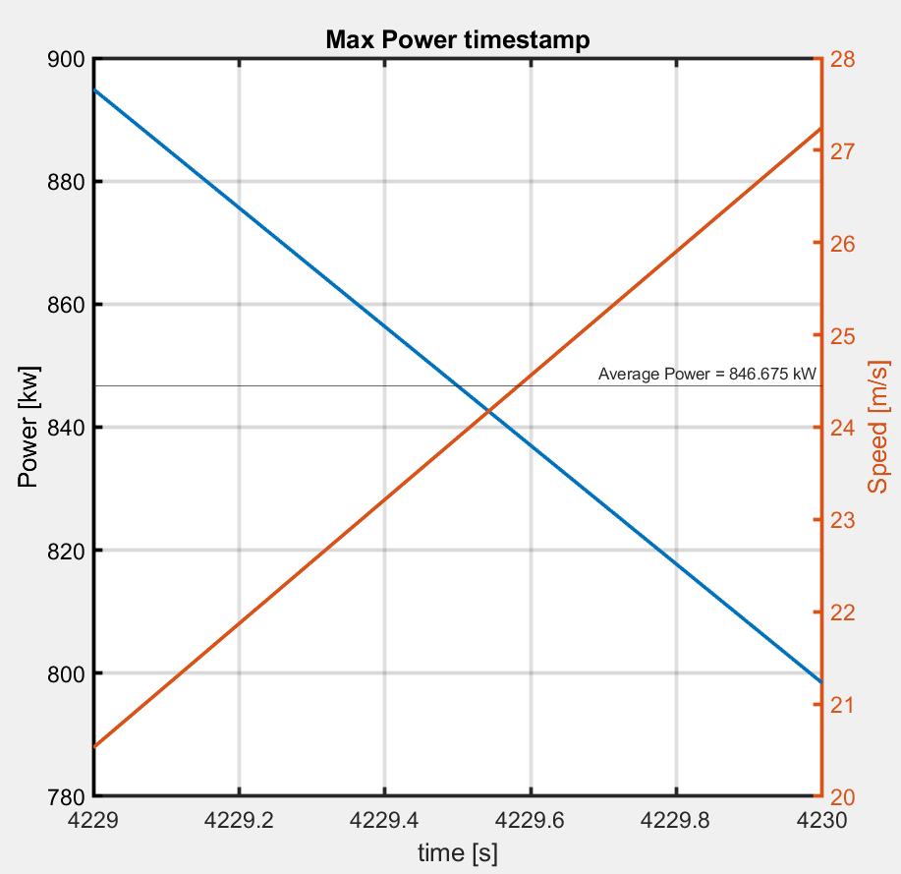
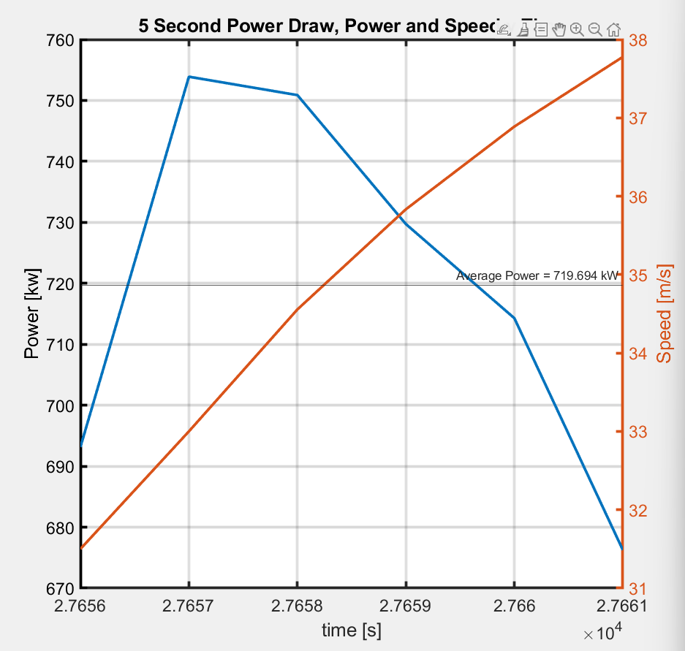

Power Demand Window (Max Energy)
Average Power =846kw
0.235kwh
Average Power =719kw
1.009kwh

Slide 5
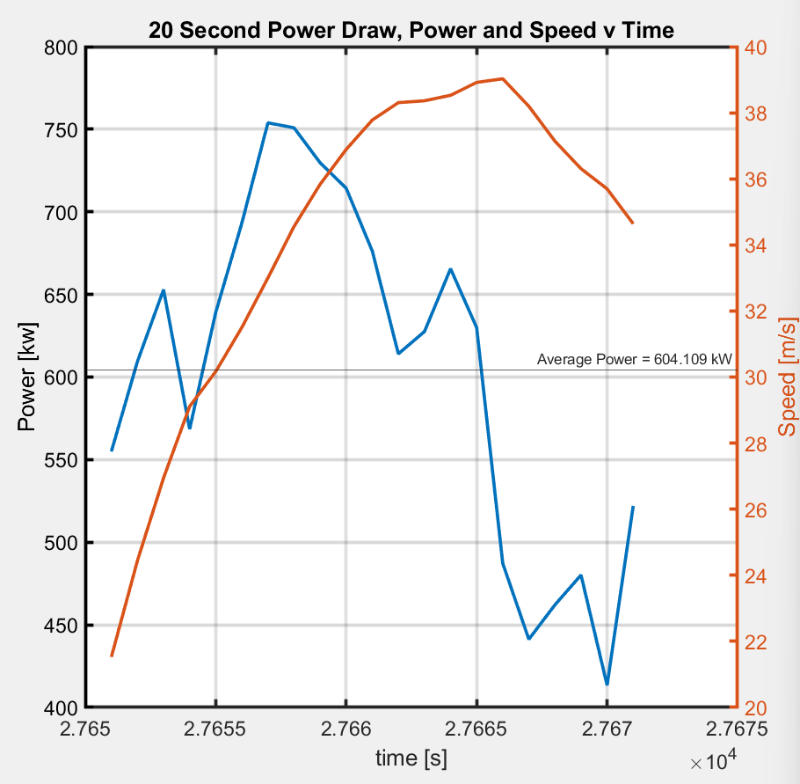
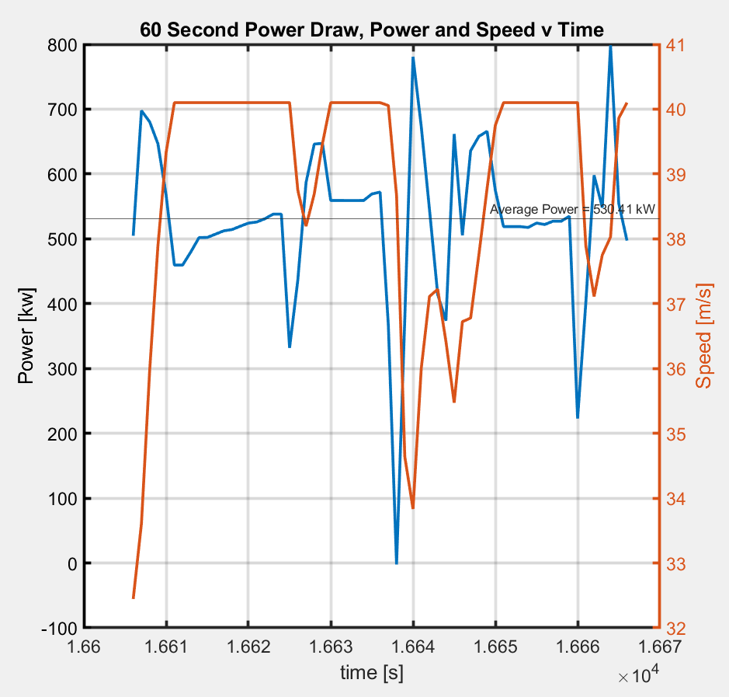
Power Demand Window (Max Energy)
Average Power = 604kw
3.374kwh
Average Power =530kw
8.849KWH

Slide 6
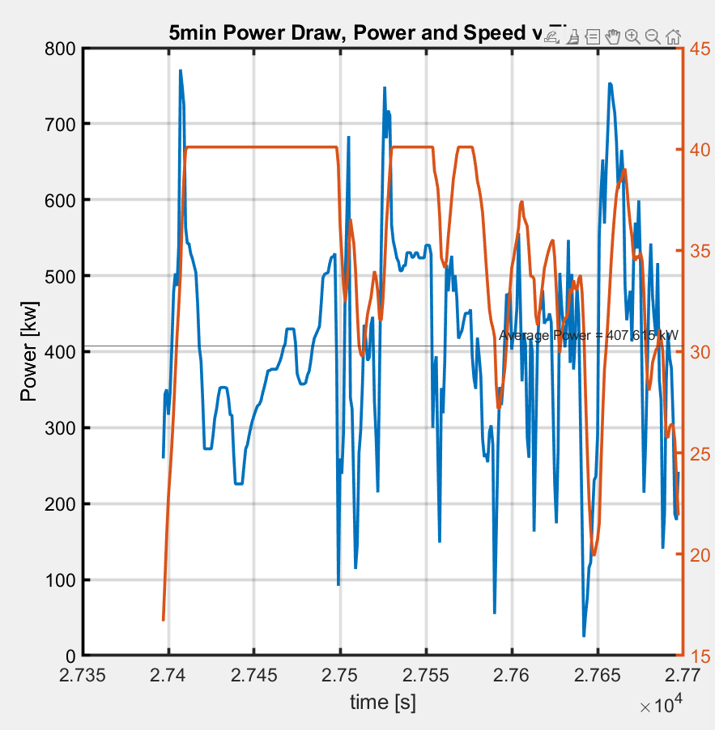
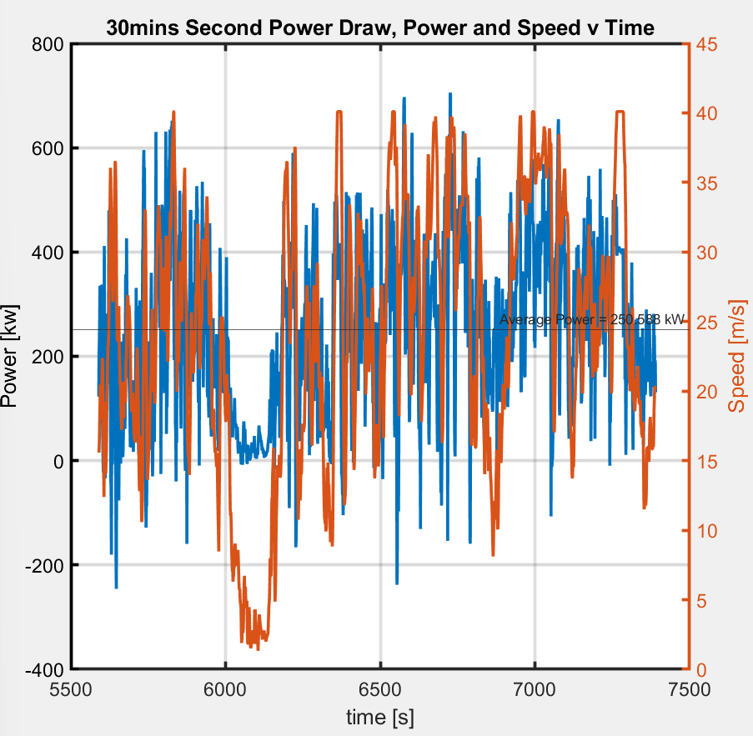
Power Demand Window (Max Energy)
Average Power = 407kw
34kwh
Average Power = 250kw
126.49kwh

Slide 7
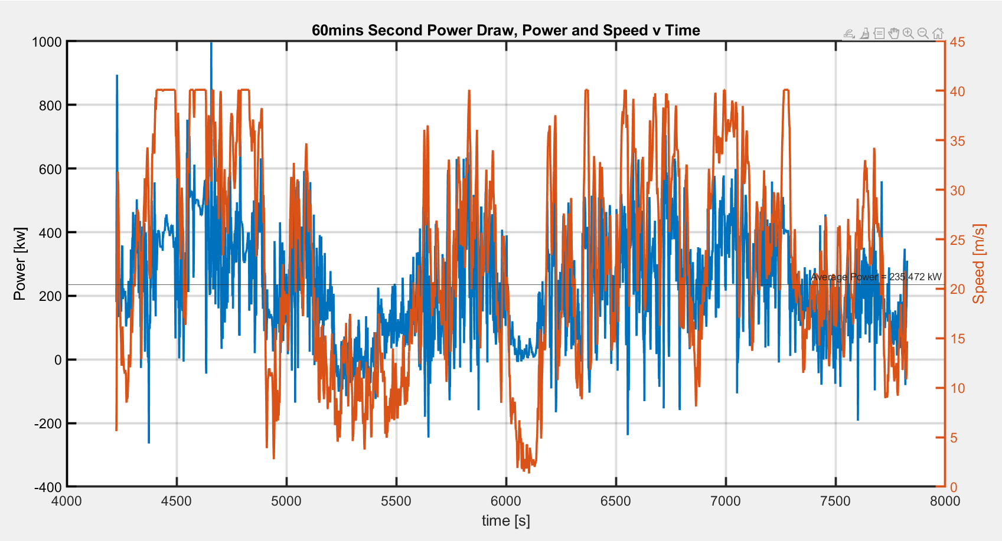
Power Demand Window (Max Energy)
Average Power = 235kw
238kwh

Slide 8
Histogram, Velocity and Power
Add histograms to this slide

Slide 9
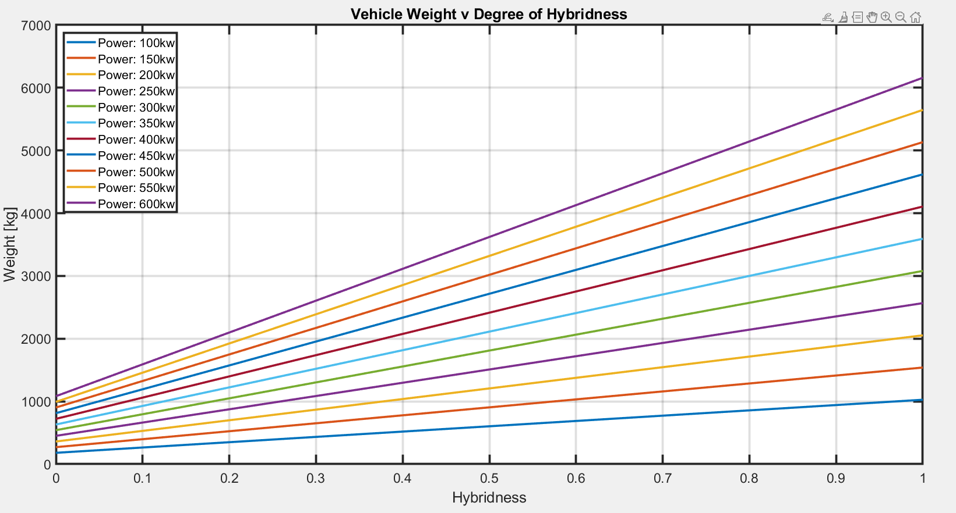
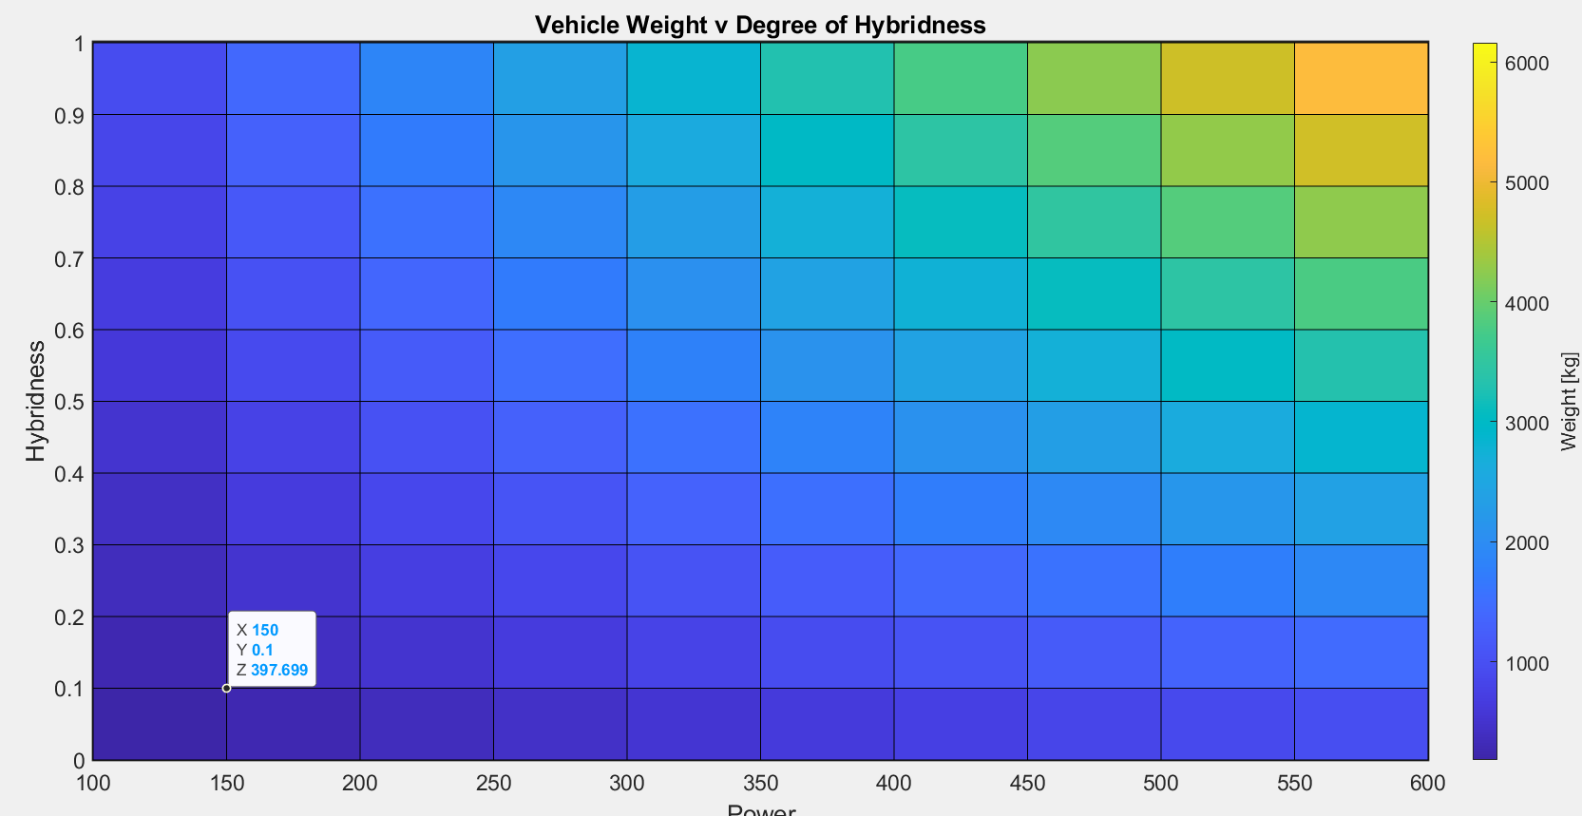
Vehicle weight as a function of hybridness and power
Motor Density | 6.666
Diesel Engine Power | 0.772
Battery Energy Density | 0.183824

Slide 10
Week 2
05/22/23 - 05/27/23

Slide 11
Questions? 5/22/23
Performance level at silent watch drivecycle?
4wd capability required for silent watch?
Silent watch Noise Level 40db - https://cleanchargenetwork.com/noise-pollution/
Heat Signature?
Assumption: Silent watch in city setting only

Slide 12
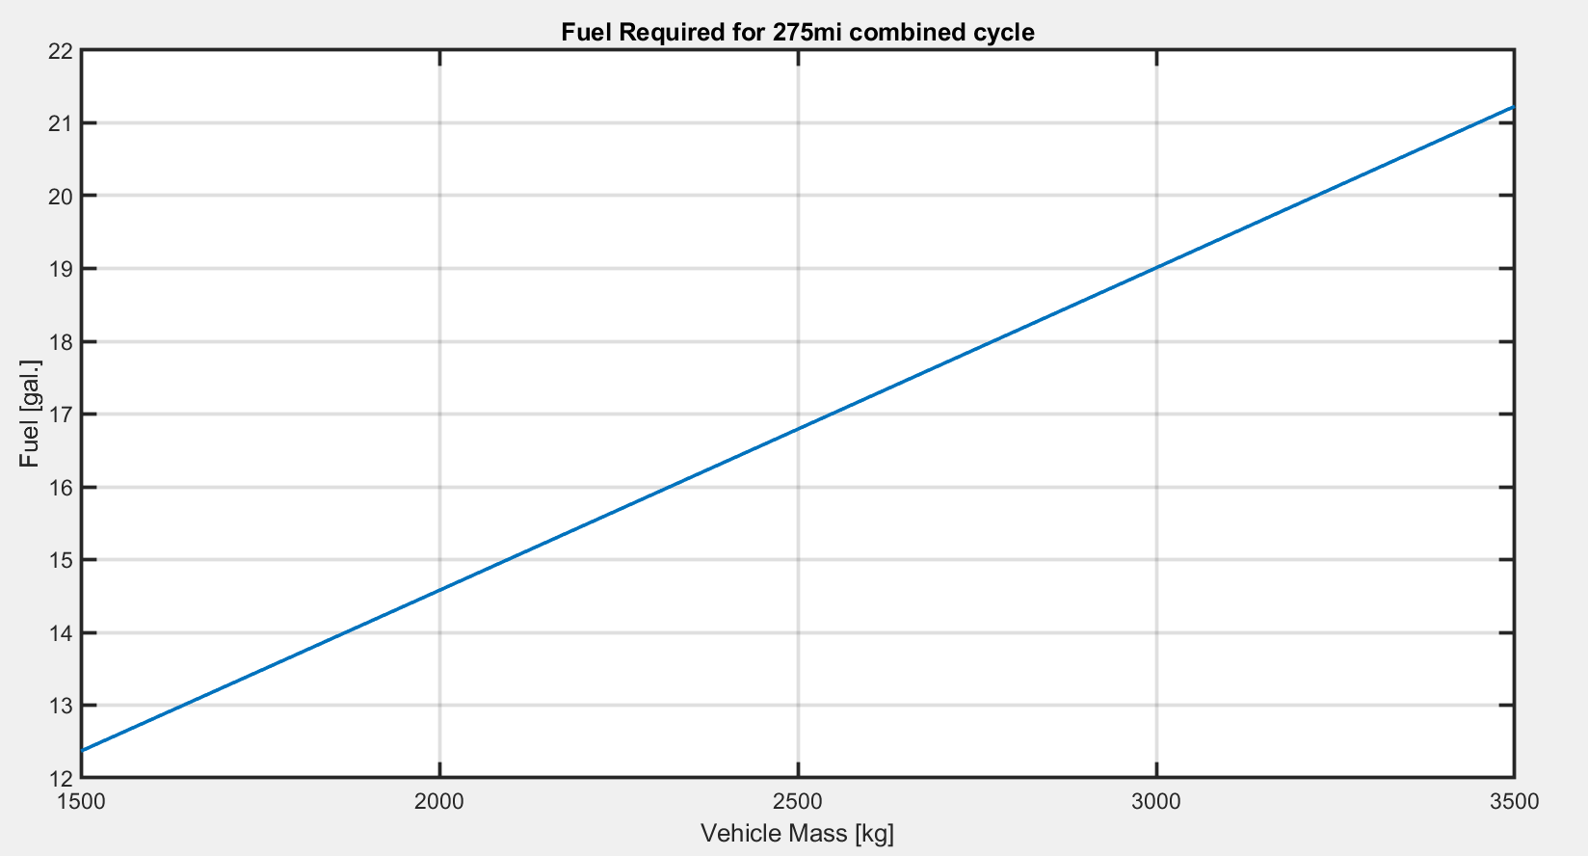
Range
Assumptions:
Vehicle Efficiency = 25%
Regen Efficiency = 15%
For 2500kg, KOH drivecycle = 4.3kwh/mi
Correction(05/30) for 3500kg – 3.93 kwh/mi
For 2500 kg – 2.86kwh/mi
Vehicle Energy Available when range 275mi = 135kwh
Refuelling required after = 31 mi
Total Distance = 180mi
Refuel Times = 180/31~ 5 times ( + 3mins JS time)
Mass Benefit = ???
If we limit to one complete refuel only
Fuel Req= ~50gal
JS First Refuel = 87mile later (distance 92miles remaining)
JS Second Refuel = 47miles later (45miles remaining)
92mi * 4.3kwh/mi = 395.6 kwh
Fuel liters = (395.6*3.6e6.*4)/42.5e6 = 43.58gal
Combine Cycle Range for 43.58Gal of fuel 805mi for 2500kg, plots in next slides.

Slide 13
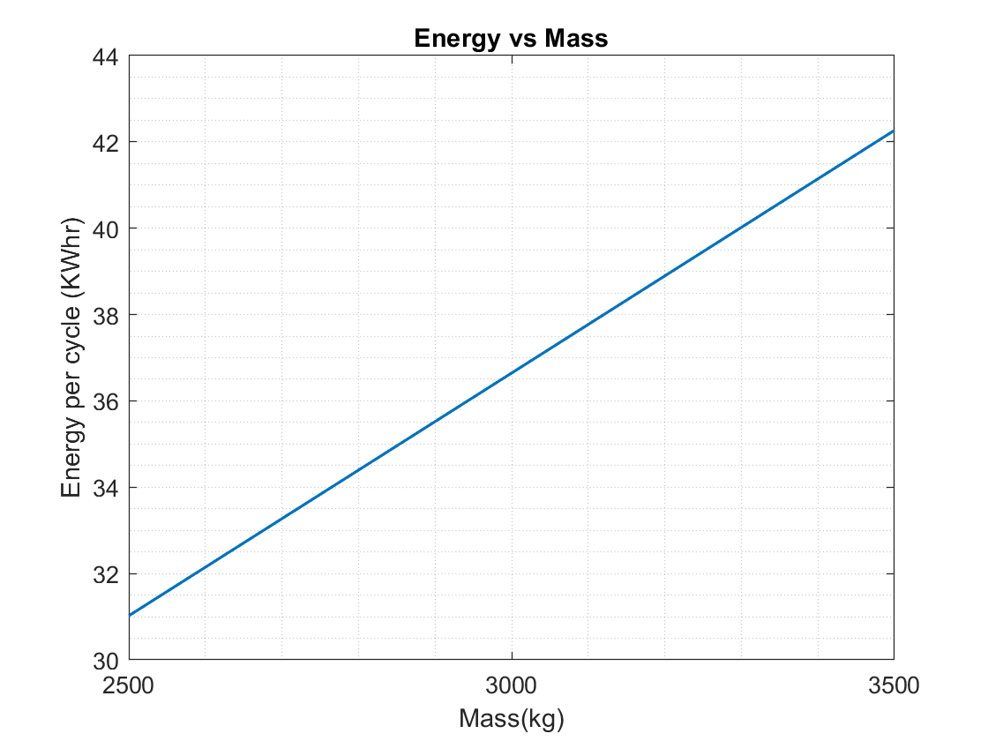
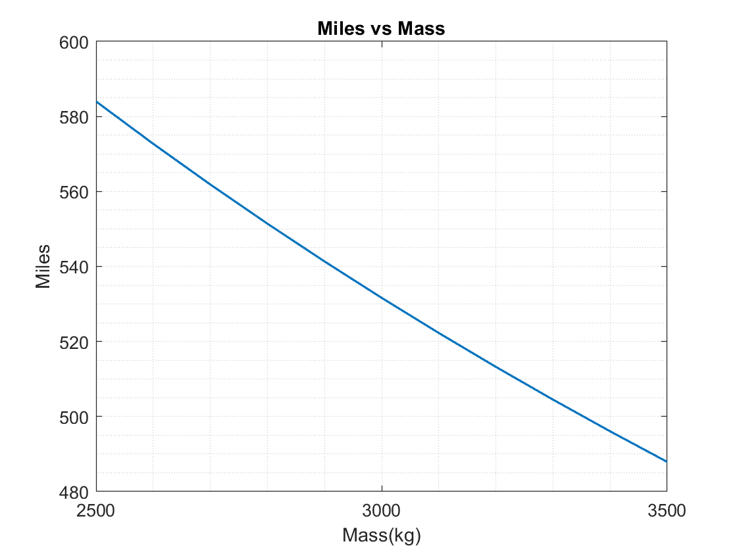
HWFET cycle
Energy required at wheels to drive one full cycle of HWFET drive cycle.
Grade is assumed to be zero degrees.
Total number of miles drivable on HWFET cycle
Total amount of fuel is 165litres.
Engine efficiency is considered 40%.
Vehicle efficiency is 20%

Slide 14
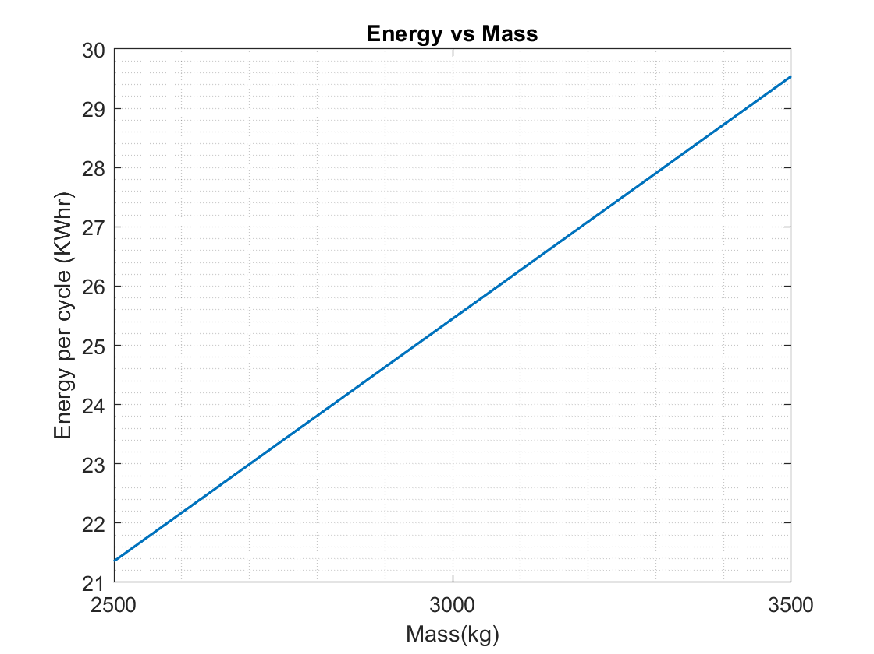
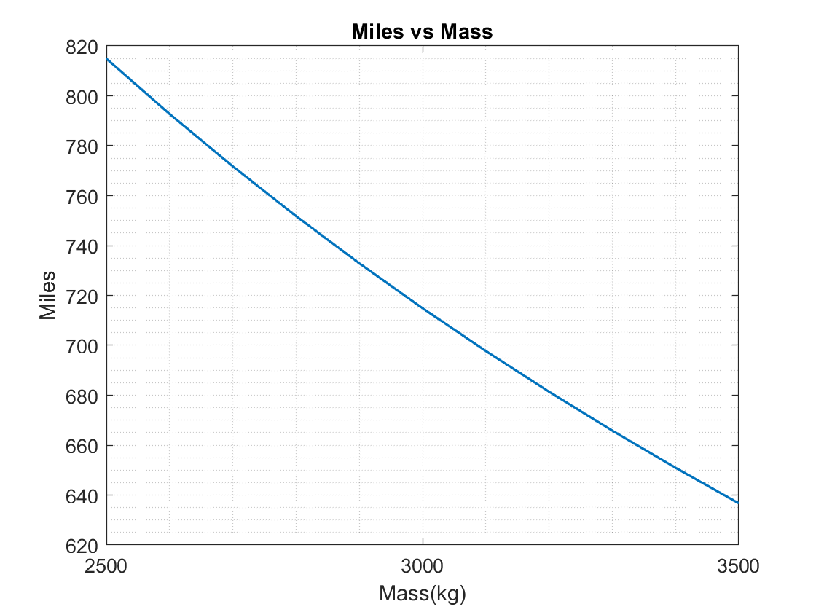
UDDS cycle
Energy required at wheels to drive one full cycle of UDDS drive cycle.
Grade is assumed to be zero degrees.
Total number of miles drivable on UDDS cycle
Total amount of fuel is 165litres.
Engine efficiency is considered 40%.
Vehicle efficiency is 20%

Slide 15
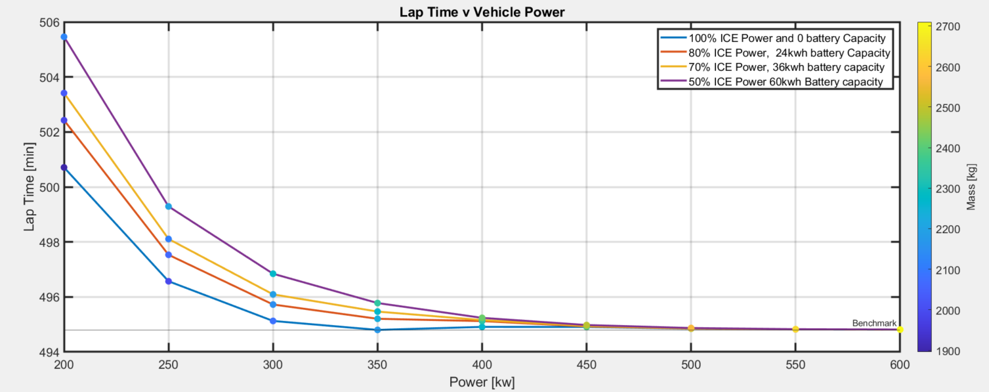
Lap Time v Vehicle Power
Sensitivity-> 0

Slide 16
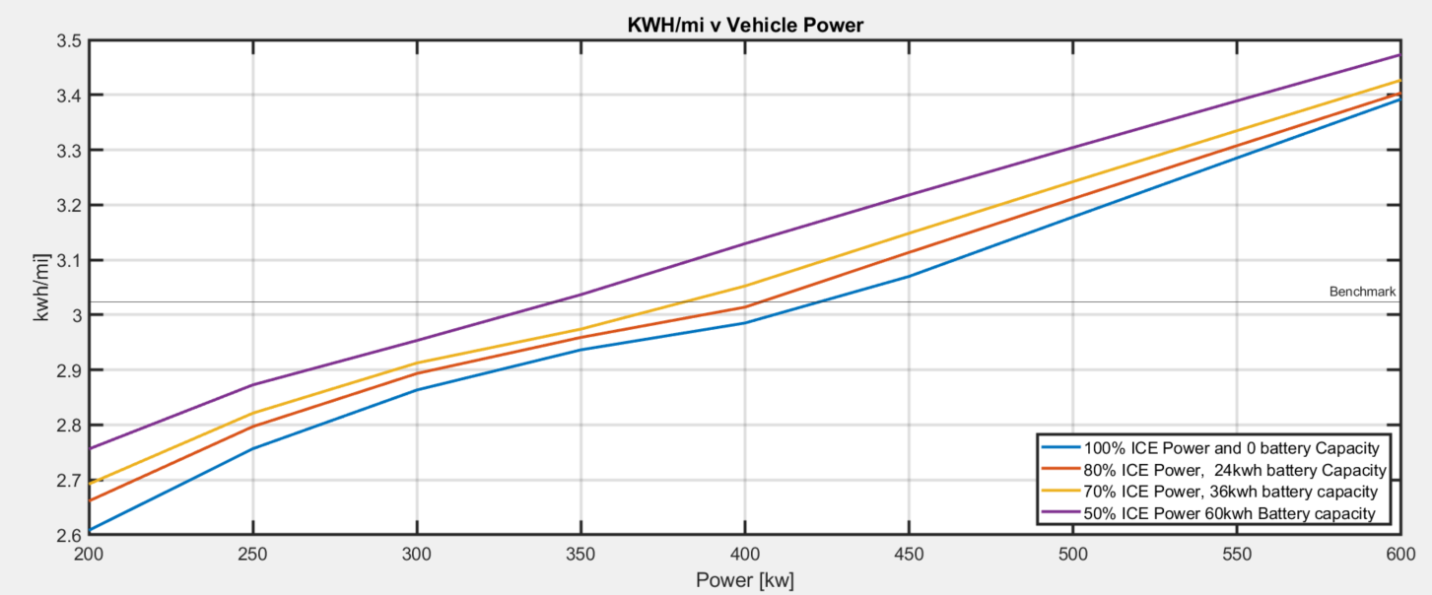
Kwh/mi

Slide 17
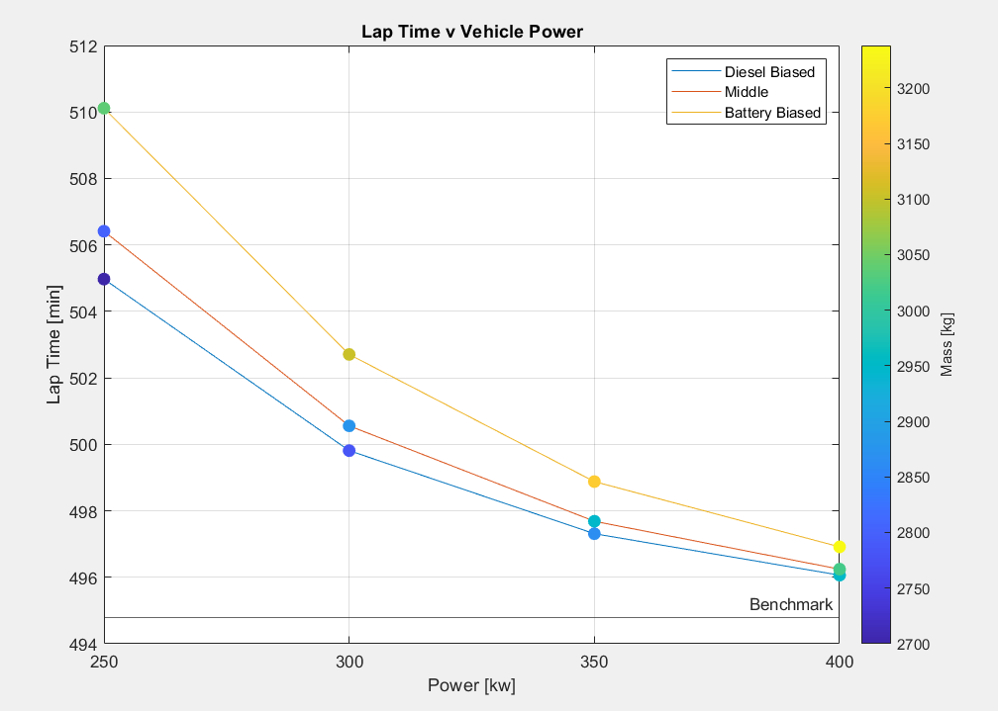
Updated Lap Time Simulations, (500kg FOS Mass)
Middle Case
250kw->300kw,5mins
300kw->350kw,~2.2mins
350kw->400kw,~1.6min

Slide 18
How to size components for series?
Need to find the trade-off between battery size and engine power requirement.
From the power profile find equation for relation between engine power and battery capacity.
Can be done by iterating through different values of engine and battery capacities and then finding a cost function that penalizes derating and full SoC? How can we consider mass and volume trade-off? Equations

Slide 19
Vehicle Mass Considerations
Base mass + DO15 powertrain system + Autonomy + Human factors ~= 2700 kg
Mass range for calculations = 2500 - 3200 kg
Jason Scherer’s vehicle’s mass (2300 kg) is considered a baseline
Powertrain mass is subtracted from the total vehicle mass to get a vehicle mass without the powertrain system (1525 kg)
Component | Qty | Weight per component (kg) | Weight with qty (kg)
Base weight | 1 | 1525 | 1525
Motors | 4 | 30 | 120
Generator | 2 | 30 | 60
Battery | 1 | 300 | 300
Engine | 1 | 229 | 229
Fuel tank | 1 | 120 | 120
DC-DC Converter | 1 | 2 | 2
DC-AC Converter | 1 | 11 | 11
Inverter | 6 | 10 | 60
Cooling system | 1 | 20 | 20
Water pump | 2 | 2.95 | 5.9
Oil pump | 6 | 4.3 | 25.8
Transmission gearbox | 4 | 0 | 0
Autonomy | 1 | 20 | 20
Human factors (Litter + Storage) | 1 | 200 | 200
Total weight |  |  | 2698.7
Component | Qty | Weight per component (kg) | Weight with qty (kg)
Benchmark (Jason Scherer) |  | 2300 | 2300
Fuel tank | 1 | 120 | 120
Transfer Case | 1 | 90 | 90
Propeller shaft | 2 | 10 | 20
Automatic Transmission | 1 | 105 | 105
Spare tire | 1 | 50 | 50
Differential with rear axle | 1 | 100 | 100
Front Differential | 1 | 15 | 15
Torque converter | 1 | 25 | 25
Engine | 1 | 250 | 250
Total Powertrain mass |  |  | 775
Jason Scherer's car with no powertrain |  |  | 1525

Slide 20
Decision Matrix for Powertrain Architecture
This table needs to be edited and finalized on Tuesday in the powertrain meeting.
Added this slide just as a placeholder
Parameter | Weightage | ICE | Series | Parallel (P2) | Through the Road (Aayush layout) | BEV
Efficiency | 5 | 1 | 4 | 2 | 3 | 5
Silent Operation Range | 5 | 1 | 4 | 2 | 3 | 5
CO2 Footprint | 1
Instant Torque Ability | 3 | 1 | 5 | 3 | 5 | 5
Number of Components | 5 | 3 | 4 | 2 | 1 | 5
Packaging | 5 | 5 | 4 | 2 | 1 | 5
Cost | 1 | 5 | 4 | 3 | 2 | 1
Engine Size | 5 | 1 | 3 | 2 | 2 | 5
Battery Size | 5 | 5 | 3 | 4 | 2 | 1
Failure Modes | 1 | 3 | 4 | 2 | 1 | 5
Mass | 5 | 5 | 4 | 3 | 2 | 1
Recharge Time | 5 | 5 | 4 | 3 | 2 | 1
PMCS Familiarity | 5 | 5 | 3 | 3 | 3 | 1
Control complexity | 1
Battery Cycling | 3 | 5 | 1 | 1 | 1 | 1
Total |  | 181 | 191 | 132 | 116 | 169

Slide 21
Week 3
05/30/23 - 06/02/23

Slide 22
Powertrain Sizing
Benchmarked Vehicle Total Mass
2300 kg
DO15 Vehicle Total Mass
2758.7 kg
Autonomy + Human Factors Mass =
220 kg
Powertrain Mass =
775 kg
Powertrain
mass = 1013.7 kg
Base Mass =
1525 kg
Base Mass =
1525 kg
Conclusion:
DO15 Vehicle Total Mass Range
2500 – 3200 kg

Slide 23
Assumptions
In order to begin sizing of powertrain components we had to start with some initial assumptions of how our vehicle parameters will be. These are also applied to the drive cycle data.
Mass = 2500 to 3200 kg
C_{d} = 0.4 https://media.ford.com/content/fordmedia/feu/en/news/2018/07/06/new-ford-transit-connect-cuts-fuel-bills-for-operators-by-up-to-.html#:~:text=Aerodynamic%20enhancements%20to%20the%20new,further%20supporting%20improved%20fuel%20efficiency. (Cd = 0.319)
A_{f} = 5m2 (Calculated using trailer dimension)
Rolling Resistance = 0.25 Source: Theory of ground vehicles, 2nd ed., J.Y. Wong, 1993, p. 17
Refuel Times = 1

Slide 24
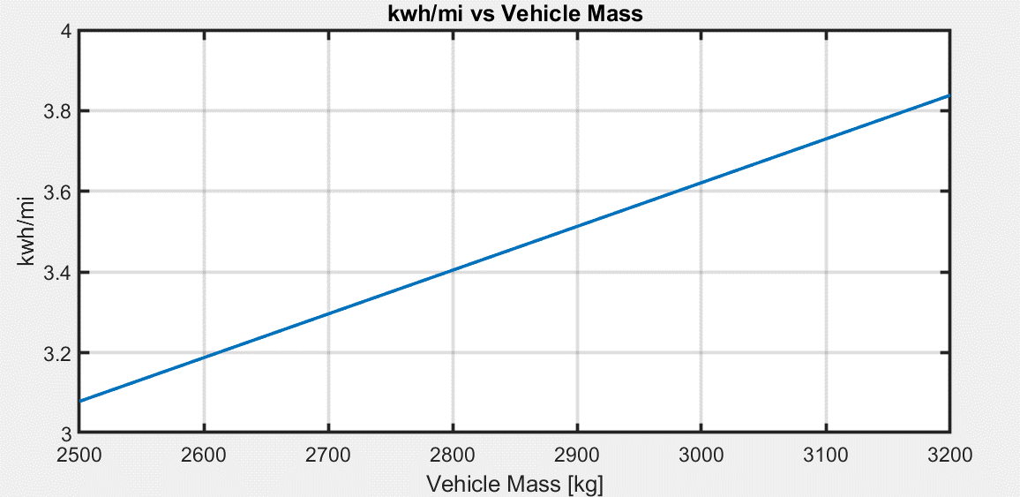
Energy per mile
kWh/mi versus vehicle mass for KOH drive cycle
kWh/mi
Energy Consumption
For 3200kg = 3.83 kWh/mi
Total distance = 180 mi
Total Energy = 689.4 kWh
Notes:
Same 1 ltr assuming 10kWhr and 25% overall vehicle efficiency
Combined Drive cycle = HWFET and UDDS
HWFET = 10 miles length
Combined DC-UDDS- FTP(75) Duration: 1877 s · Distance traveled: 11.04 miles (17.77 km) · Average speed: 21.2 mph (34.12 km/h). · Maximum speed: 56.7 mph (91.25 km/h).

Slide 25
Drive cycle analysis - Max tractive force
Max Tractive force = 26601 N
Duration = 10 seconds continuous
Mass = 3200 kg
Grade = 40°
Speed = 15 kmph
Longitudinal Acceleration = 0.13 m/s2

Slide 26
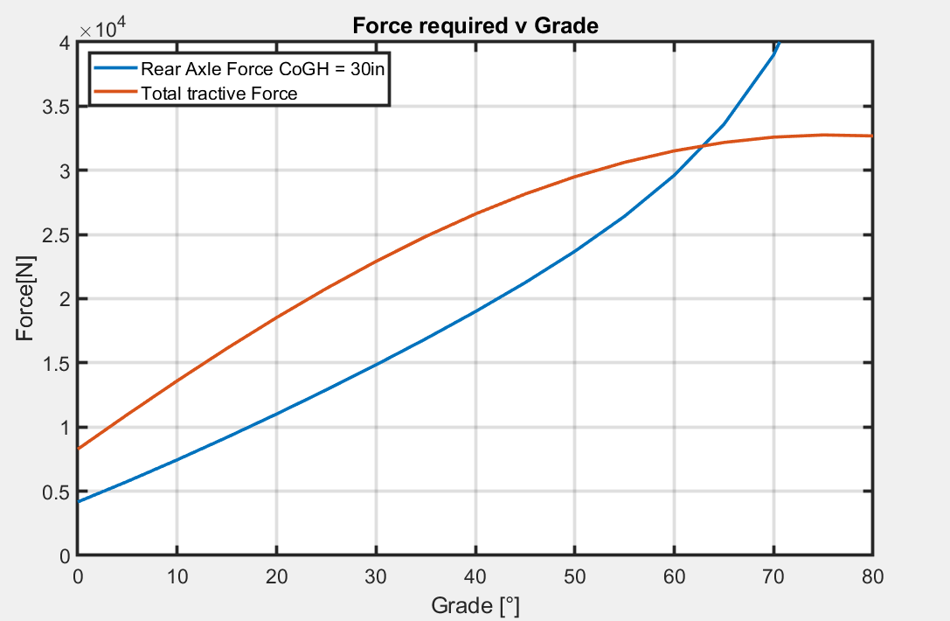
Drive cycle analysis - Max tractive force
Front axle loses ground contact
Assuming wheelbase 120in, CoG Height 30in
The force required at the rear axle increase as the grade increases. Since KoH has a wide variety of grades, to maximize longitudinal acceleration we need an accurate split between front and rear axle torques.
This will also help us select the maximum reduction ratio.

Slide 27
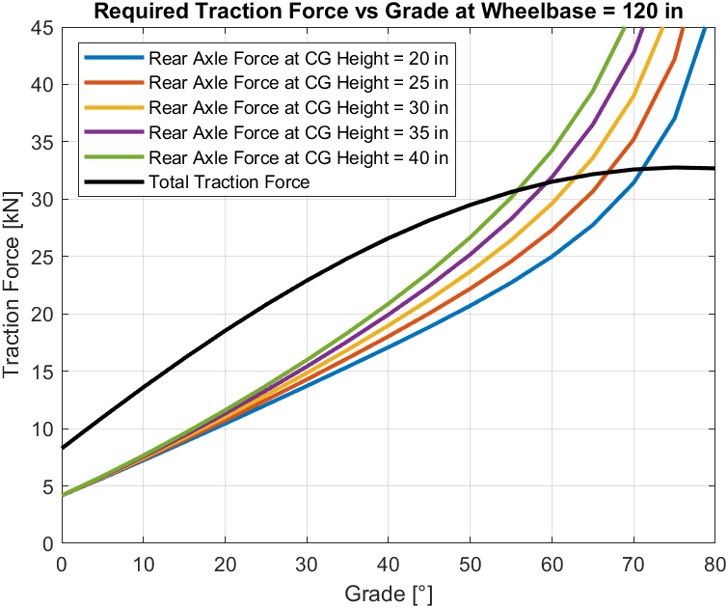
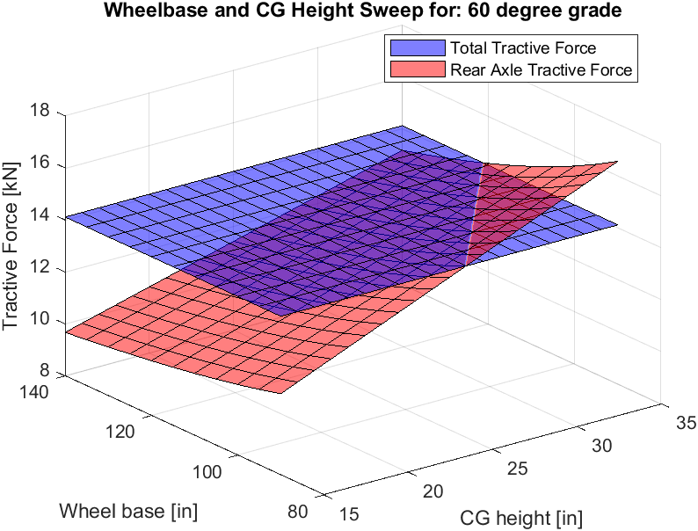
Drive cycle analysis - Max tractive force
Front axle loses ground contact

Slide 28
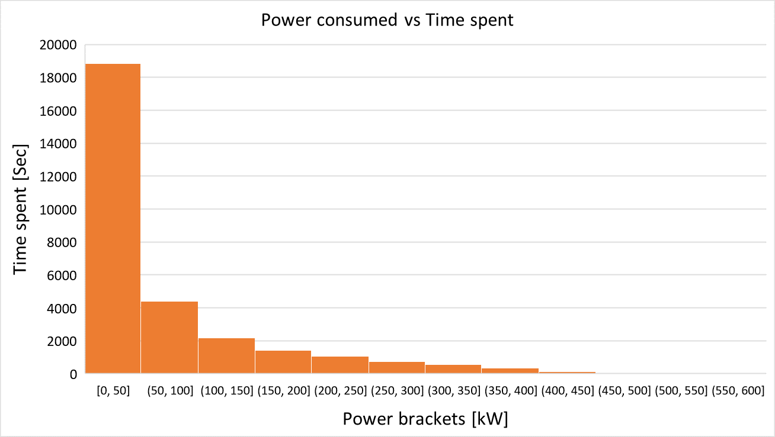
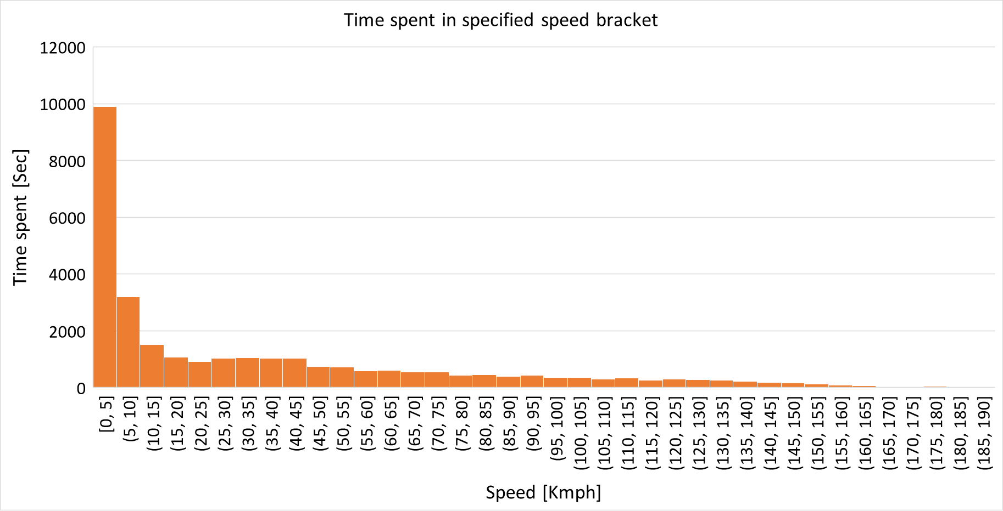
Observations from KOH drive cycle
Difference between winner and runner-up time:
2021 : 540 sec (9 min)
2022: 900 sec (15 min)
2023: 71 sec
Power band (kW) | % time of total race
500-600 | less than 1%
350-500 | 3%
0-50 | 60%
50-100 | 6.7%
Speed band (kmph) | % time of total race
185-190 | less than 1%
175-180 | less than 1%
0-15 | 50%
15-45 | 6%
Notes:
Caping power and maximizing power utilization
Higher power is not the limitng as we reached higher speeds, one of the can be he is moving downhill and reaching the speeds ? Can be

Slide 29
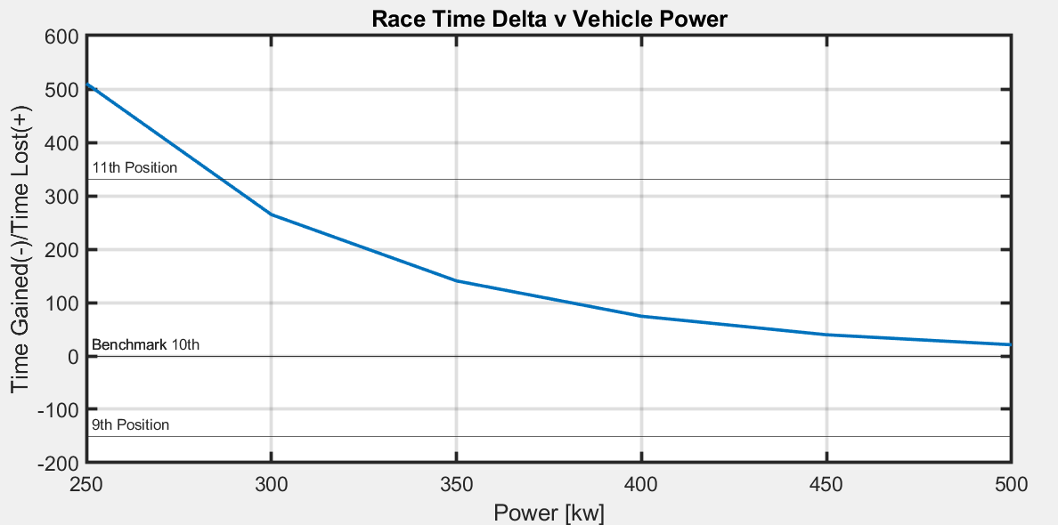
Total Race Time Analysis
Mass = 2700 kg
Assumptions:
Mass is not affecting lateral performance
Velocity profile of a given competitive lap around KoH is the best possible velocity profile. Gains can come only through acceleration, but losses in time can come through limited velocity (power is clipped)
Energy limitations have not been considered in this simulation. (next slide)
Diesel Power Density = 0.772kw/kg
Battery Energy Density = 0.18 kwh/kg
Motor Power Density = 6.66 kw/kg
Reducing Slope
Time Gained(-)/Time Lost(+) [seconds]
Mass = 3400 kg

Slide 30
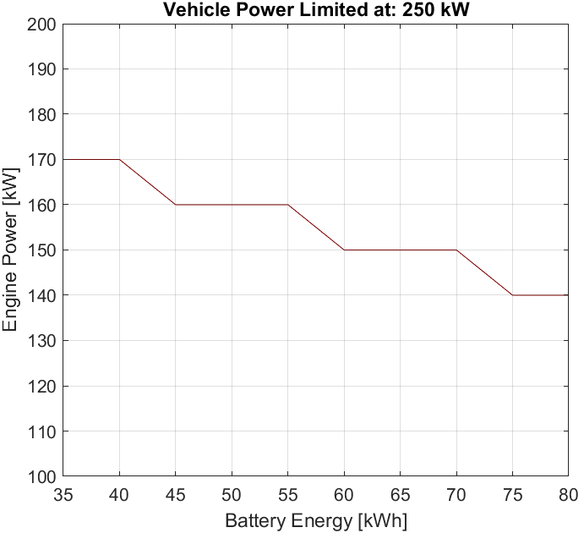
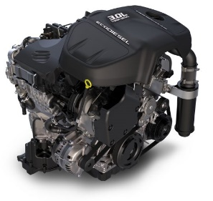
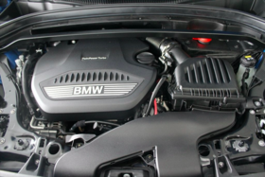
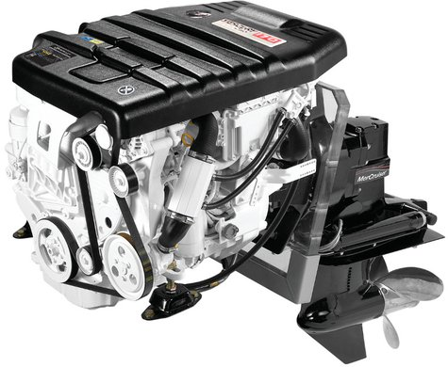
Powertrain Sizing: Options
1C Discharge
3.0L Jeep Wrangler
Battery Pack 37.5 kWh
1.
850mm
749mm
1
Favorable Region
2
880mm
0 Derate Line
2.
2.0 L BMW B47
Battery Pack 53 kWh
(Dimensions approximated)
780mm
3
600mm
2C Discharge
700mm
Derate Region
Instances of energy demand> energy of hybrid powertrain
757mm
2.0 L Mercury 2.0L
Battery Pack 80 kWh
3.
802mm
710mm
Notes:
Derating condition: The system operates at a reduced capacity Derating condition: When the power demand from the drive cycle is greater than what the system can supply, it is considered as 1 derate point.
1. 170kW Engine, Jeep Wrangler 3.0L
Mass = 229.55 kg Vol = 0.56m3
37.5kWh Battery pack
Mass = 240kg Vol = 0.213
Total Mass = 469.55 kg, Vol = 0.77m3
2. 150KW Engine, 2.0L BMW B47/N47
Mass = 179 kg Vol = 0.5 m3 (Estimate)
56kWh Battery pack
Mass = 330 kg Vol = 0.35 m3
Total Mass = 509 kg, Vol = 0.85 m3 (Estimate)
3. 140kW Engine Mercury 2.0L Diesel (127kW) or Ford Ecoblue (140-175 kW.)
Mass = 264kg Vol = 0.431m3
>=80kWh Battery Pack
Mass = 588kg Vol = 0.428m3
Total Mass = 852kg Vol = 0.85m3
or performance level compared to its maximum designed or rated capability.
Power demand from the drive cycle is greater than the available power.
Assumptions:
Engine always ON
Engine transient = 0
Battery energy range 35 to 80 kWh
Engine range 100 to 200 kW
Driveline efficiency: 0.95
Engine/Generator efficiency: 0.95

Slide 31
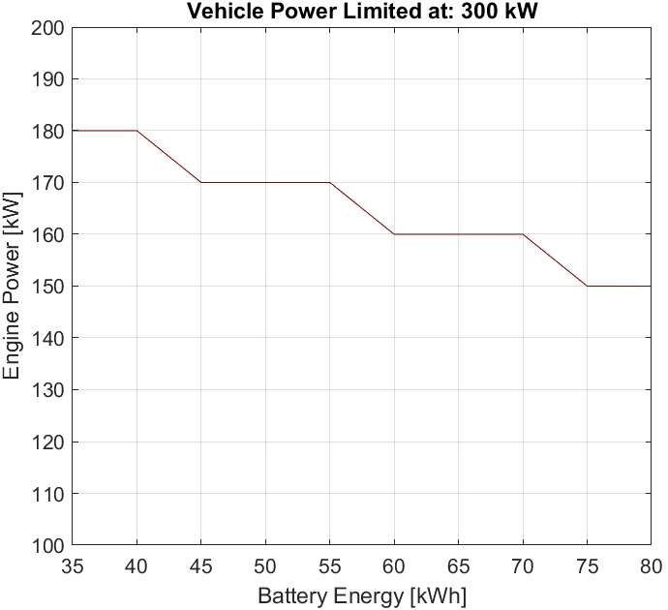
Powertrain Sizing: Options
3.0L Jeep Wrangler Battery Pack 37.5 kWh
Favorable Region
1.
850mm
1
749mm
0 Derate Line
2
880mm
3
2.
720mm
Cummins R2.8 Turbo Diesel
Battery Pack 53 kWh
Derate Region
Instances of energy demand> energy of hybrid powertrain
638mm
635mm
757mm
2.0 L Mercury 2.0L
Battery Pack 80 kWh
3.
802mm
710mm
Notes:
Derating condition: The system operates at a reduced capacity or performance level compared to its maximum designed or rated capability.
Power demand from the drive cycle is greater than the available power.
Assumptions:
Engine always ON
Engine transient = 0
Battery energy range 35 to 80 kWh
Engine range 100 to 200 kW
Driveline efficiency: 0.95
Engine/Generator efficiency: 0.95

Slide 32
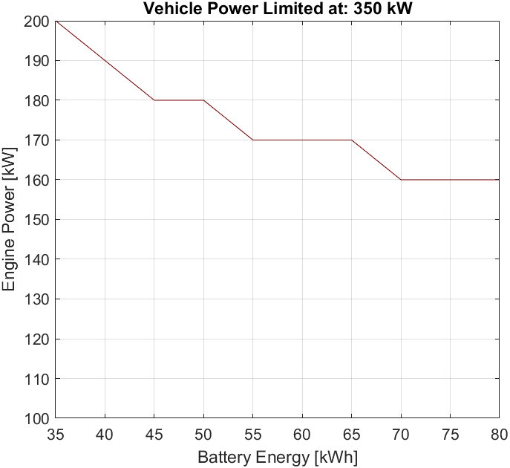
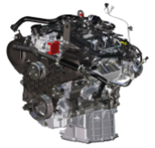
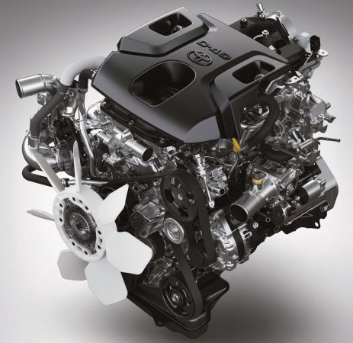
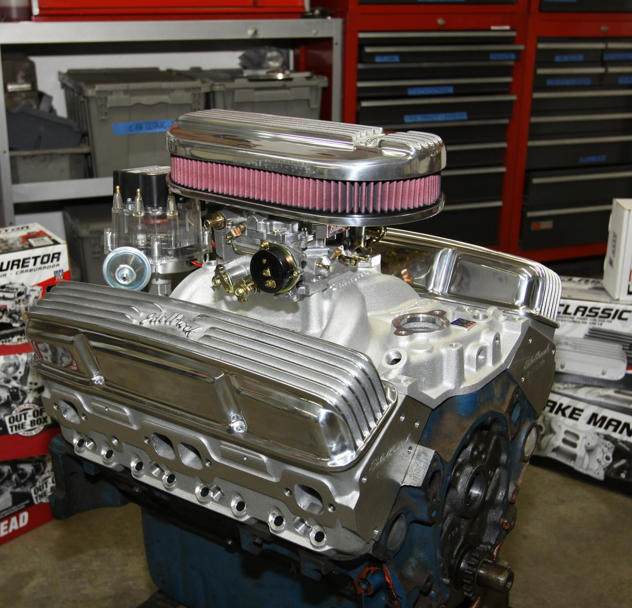
Powertrain Sizing: Options
1
3.0L Ford V6
Battery Pack 37.5 kWh
Favorable Region
1.
708mm
0 Derate Line
2
915mm
3
882mm
2.
720mm
2.8 L Toyota Hilux
Battery Pack 53 kWh
880mm
Derate Region
Instances of energy demand> energy of hybrid powertrain
700mm
559mm
Chevy small block 305
Battery Pack 80 kWh
3.
510mm
747mm
Notes:
Derating condition: The system operates at a reduced capacity or performance level compared to its maximum designed or rated capability.
Power demand from the drive cycle is greater than the available power.
Assumptions:
Engine always ON
Engine transient = 0
Battery energy range 35 to 80 kWh
Engine range 100 to 200 kW
Driveline efficiency: 0.95
Engine/Generator efficiency: 0.95

Slide 33
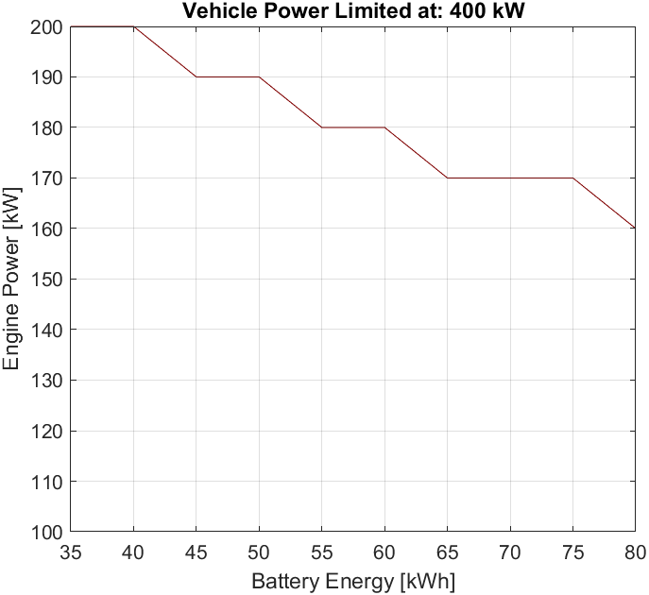
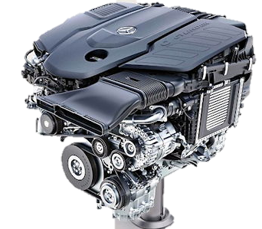
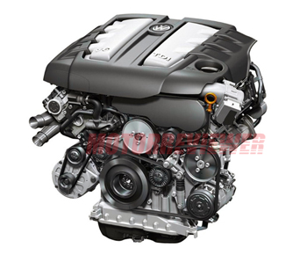
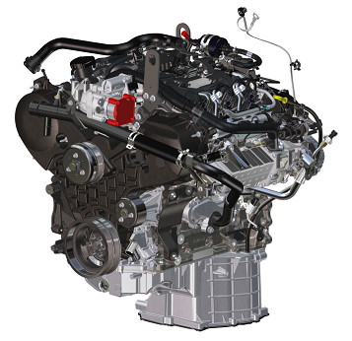
Powertrain Sizing: Options
1
Favorable Region
0 Derate Line
2.9L Mercedes-Benz OM656
Battery Pack 43 kWh
2
1.
3
2.
?
3.0 L Audi/VW
Battery Pack 63 kWh
?
Derate Region
Instances of energy demand> energy of hybrid powertrain
?
882mm
3.0L Ford V6
Battery Pack 77 kWh
3.
915mm
708mm
Notes:
Derating condition: The system operates at a reduced capacity or performance level compared to its maximum designed or rated capability.
Power demand from the drive cycle is greater than the available power.
Assumptions:
Engine always ON
Engine transient = 0
Battery energy range 35 to 80 kWh
Engine range 100 to 200 kW
Driveline efficiency: 0.95
Engine/Generator efficiency: 0.95

Slide 34
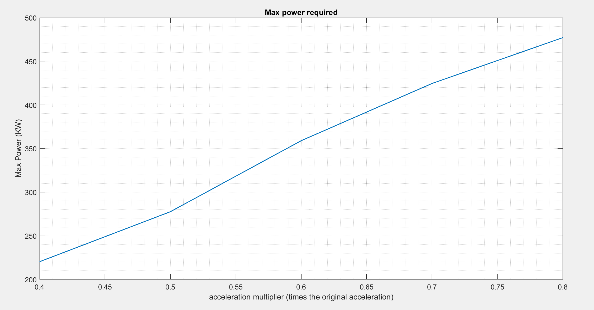
Scaled Downed accleration
Mass – 3500 kg
Coeff of drag – 0.4
Roll rest – 0.25
Frontal area – 5m^2
Dens of air – 1.224kg/m^3
Original acceleration required for KOH drive cycle is scaled down in the range of 0.4 to 0.8 times.

Slide 35
Engines -
384KW - https://www.internationaltrucks.com/engines/s13integrated?gclid=Cj0KCQjw7uSkBhDGARIsAMCZNJti4LDwxLqCitfLFbtcxt8L07rEOgSp_-tDN4MmaENh4WvxMGG2GokaAlGeEALw_wcB
206KW -GM Duramax 3.0-Liter I-6 LM2 Turbo Diesel Engine
https://gmauthority.com/blog/gm/gm-engines/lm2/
270KW - https://gmauthority.com/blog/gm/gm-engines/gm-6-6-liter-lbz-v-8-duramax-turbo-diesel-engine/
260KW - https://motortrucks.com/2022-international-cv-series-new-truck
180KW - https://www.caranddriver.com/audi/a6/specs/2014/audi_a6_audi-a6_2014 (AUDI V6 3.0/ on eBay)
210KW - https://www.car.info/en-se/bmw/3-series/335d-6613258/specs (BMW 335d / 3.0L inline 6)
177KW - https://ultimatespecs.com/car-specs/Jaguar/11774/Jaguar-XF-(X250)-30-V6-Diesel-Premium-Luxury-240HP.html (Jaguar 3.0L V6)

Slide 36
Mercury® Diesel: 3.0L (150-270hp) https://www.mercurymarine.com/en/us/engines/diesel/mercury-diesel/30l-150-270hp/#specifications
Lexus LX500d : 3.3L V6 (227KW) https://www.drive.com.au/reviews/2022-lexus-lx500d-review/
Porsche 3.0 L V6 (193KW) https://www.ultimatespecs.com/car-specs/Porsche/69729/Porsche-Cayenne-II-Diesel.html
(271 )Maserati Ghibli III Diesel 275HP https://www.ultimatespecs.com/car-specs/Maserati/108188/Maserati-Ghibli-III-Diesel-275HP.html
Cummins 6.7L V6 (370 - 420 hp) https://www.cummins.com/engines/cummins-67l-turbo-diesel-2021
JLR AJ300D 3.0L I6 (257KW) https://en.wikipedia.org/wiki/Ingenium_engine_family
Volvo D13 13.0L I6 (372KW) https://www.volvotrucks.us/trucks/powertrain/d13/
Volvo D11 10.8L I6 (314KW) https://www.volvotrucks.us/trucks/powertrain/d11/
Mercedes OM656 3.0L I6 (250KW) https://en.wikipedia.org/wiki/Mercedes-Benz_OM656_engine
Toyota Hilux 2.8L I4 turbo diesel (150KW) https://newsroom.toyota.eu/new-hilux---a-more-powerful-engine-for-a-striking-design/

Slide 37
Engines -
175KW - https://www.ziptuning.com/news/2020-mercedes-benz-v300d-turbo-diesel-239-0ps-om654-2-0-automatic-transmission-bosch-md1cp001-stage-1/
298 kW - https://www.carthrottle.com/post/bmw-s-incredible-quad-turbo-750d-serves-up-a-massive-400bhp-and-560lb-ft/
https://www.torquecars.com/bmw/b57-tuning.php
DD8 - (260 -350 HP) - https://freightliner.com/demand-detroit/engines/dd8/
Bentley Bentayga 4.0L V8 diesel (320KW) - https://www.carexpert.com.au/bentley/bentayga/2020-diesel-2cce954b
165 kW - https://en.wikipedia.org/wiki/Volvo_D5_engine
384 kW - https://www.motortrend.com/how-to/5-9-liter-cummins-diesel-engine/
https://dieselprogrammers.com/collections/cummins-tuners/products/smarty-touch-programmer?variant=16264533114926

